Slide 1
Spam Detection Algorithms
Project 22
Emma Fletcher, Anne Tansengco, Skyllar Estill, Molly Iverson

Slide 2
Data Preprocessing
Removed punctuation and stop words from emails.
Original:
Subject: do not have money , get software cds from here ! software compatibility . . . . ain ' t it great ? grow old along with me the best is yet to be . all tradgedies are finish ' d by death . all comedies are ended by marriage .
Processed:
Subject: money get software cds software compatibility great grow old along best yet tradgedies finish death comedies ended marriage

Slide 3
K-Nearest Neighbors (KNN)
Take preprocessed emails and split the data into training and testing (70/30 split)
Run KNN algorithm
Take each email in the training data and make a dictionary that counts each word in the email
For each testing email, do the same. Then, find the Euclidian distance from each testing email to each training email
If the K-closest emails are majority spam, label the testing email spam. Else, label it ham.

Slide 4
K-Nearest Neighbors (KNN) - Additional Steps
We tested using both Manhattan and Euclidean distance
Euclidean distance had more accuracy
To find the best K value, we ran the data 17 times, testing for accuracy each time. We found that K=11 provided the most accurate results

Slide 5
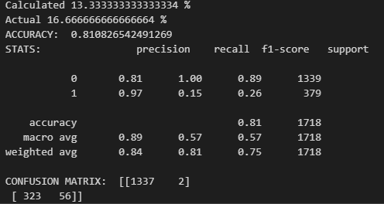
K-Nearest Neighbors (KNN) - Results
K=11 had a spam detection accuracy of 81%. Predicted 2 false positive results and 323 false negatives.

Slide 6
Naive Bayes - Preprocessing
Take preprocessed emails and split the data into training and testing (70/30 split)
We used feature selection method SelectKBest to find the top 100 words that are considered most relevant for classifying emails as spam or not spam

Slide 7
Naive Bayes
Run Naive Bayes algorithm
Define a Naive Bayes Classifier class
Train the classifier using training data. It learns the probability distributions of the features given the class label (spam or ham)
Predict the class labels for the test data

Slide 8
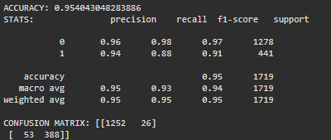
Naive Bayes - Results
Naive Bayes had a spam detection accuracy of 95%. Predicted 26 false positive results and 53 false negatives.

Slide 9
C4.5 Decision Tree - Processing
Take preprocessed emails and split the data into training and testing (70/30 split) to follow the same split ratio of KNN and Naïve Bayes
Use LabelEncoder and CountVectorizer to get the matrices for features and labels.

Slide 10
C4.5 Decision Tree
Run C4.5 Algorithm
Define C4.5 classifier by building a tree recursively based on the training data
Determine best split nodes by calculating information gain
Leaf nodes contain our decisions
Predict results by looping through each test data point and searching the tree appropriately until you arrive at a leaf node

Slide 11
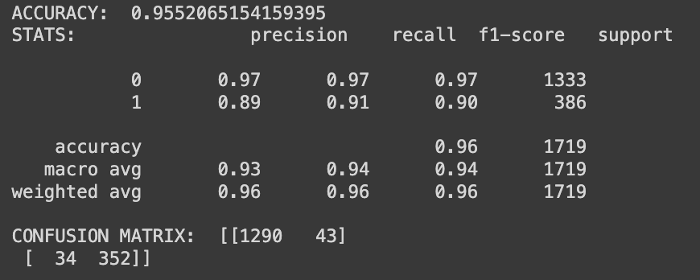
C4.5 Decision Tree - Results
C4.5 had a spam detection average around 95% consistently for the whole data set. It predicted 43 false positives and 34 false negatives for this specific configuration of training and test values.

Slide 12
Discussion
KNN algorithm had the lowest accuracy out of the three algorithms
Naïve Bayes and C4.5 Decision Tree both had very high accuracies, being on par with each other
Drawback to C4.5 Decision Tree - takes up more time/space in comparison to Naïve Bayes due to recursive nature of decision tree
Naïve Bayes seems to be best algorithm for its high accuracy and quick performance

